Slide 1
Software Testing and Quality Assurance
(Course Code - E2UC502T)

Slide 2
Course Outline
Building Test Cases and Plans
Format of test case.
Test data selection.
Branch coverage, statement coverage.
Pre-condition and post-condition.
Test schedule and check pointing.
Du, dc and other data paths.
suitable exercises for creating test cases for each type of Testing techniques.

Slide 3
Introduction
A test case is a defined format for software testing required to check if a particular application/software is working or not.
A test case consists of a certain set of conditions that need to be checked to test an application or software i.e. in more simple terms when conditions are checked it checks if the resultant output meets with the expected output or not.
A test case consists of various parameters such as ID, condition, steps, input, expected result, result, status, and remarks.

Slide 4
When do we write Test Cases?:
Test cases are written in different situations:
Before development: Test cases could be written before the actual coding as that would help to identify the requirement of the product/software and carry out the test later when the product/software gets developed.
After development: Test cases are also written directly after coming up with a product/software or after developing the feature but before the launching of a product/software as needed to test the working of that particular feature.
During development: Test cases are sometimes written during the development time, parallelly. so whenever a part of the module/software gets developed it gets tested as well.

Slide 5
Why Write Test Cases?:
Test cases are one of the most important aspects of software engineering, as they define how the testing would be carried out. Test cases are carried out for a very simple reason, to check if the software works or not. There are many advantages of writing test cases:
To check whether the software meets customer expectations: Test cases help to check if a particular module/software is meeting the specified requirement or not.
To check software consistency with conditions: Test cases determine if a particular module/software works with a given set of conditions.
Better test coverage: Test cases help to make sure that all possible scenarios are covered and documented.
For consistency in test execution: Test cases help to maintain consistency in test execution. A well-documented test case helps the tester to just have a look at the test case and start testing the application.
Helpful during maintenance: Test cases are detailed which makes them helpful during the maintenance phase.

Slide 6
Standard Test Case Format
Test Case ID, Test Scenario, Test Steps, Prerequisites, Test Data, Expected/Intended Results, Actual Results, Test Status – Pass/Fail
While writing test cases, remember to include:
A reasonable description of the requirement.
A description of the test process.
Details related to testing setup: version of the software under test, data points, OS, hardware, security clearance, date, time, prerequisites, etc.
Any related documents or attachments testers will require.

Slide 7
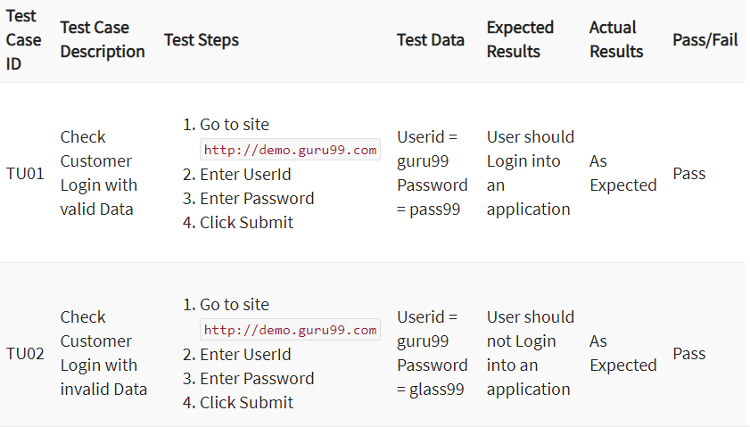
Format of Test Cases:

Slide 8
Best Practice for Writing Test Case:
Simple and clear: Test cases need to be very concise, clear, and transparent. They should be easy and simple to understand not only for oneself but for others as well.
Maintaining the client/customer/end-user requirements must be unique: While writing the test cases, it’s necessary to make sure that they aren’t being written over and over again and that each case is different from the others.
Zero Assumptions: Test cases should not contain assumed data, and don’t come up with features/modules that don’t exist.
Traceability: Test cases should be traceable for future reference, so while writing it’s important to keep that in mind,
Different input data: While writing test cases, all types of data must be taken into consideration.
Strong module name: The module name should be self-explanatory while writing the test case.
Minimal Description: The description of a test case should be small, one or two lines are normally considered good practice, but it should give the basic overview properly.
Maximum conditions: All kinds of conditions should be taken into consideration while writing a test, increasing the effectiveness.

Slide 9
Best Practice for Writing Test Case:
Meeting requirements: While writing the test case the client/customer/end-user requirements must be met.
Repetitive Results: The test case must be written in such a way that it should provide the same result.
Different Techniques: Sometimes testing all conditions might not be possible but using different testing with different test cases could help to check every aspect of a software.
Create test cases with the end user’s perspective: Create test cases by keeping end-user in mind and the test cases must meet customer requirements.
Use unique Test Case ID: It is considered a good practice to use a unique Test Case ID for the test cases following a naming convention for better understanding.
Add proper preconditions and postconditions: Preconditions and postconditions for the test cases must be mentioned properly and clearly.
Test cases should be reusable: There are times when the developer updates the code, then the testers need to update the test cases to meet the changing requirements.
Specify the exact expected outcome: Include the exact expected result, which tells us what will be result of a particular test step.

Slide 10
Formal and Informal Test Case:
Formal Test Cases: Formal test cases are test cases that follow the basic test case format. It contains the test case parameters such as conditions, ID, Module name, etc. Formal Test cases have set input data and expected results, they are performed as per the given order of steps.
Informal Test Cases: Informal test cases are test cases that don’t follow the basic test case format. In these, as the tests are performed the test cases are written in real-time then pre-writing them, and the input and expected results are not predefined as well.

Slide 11
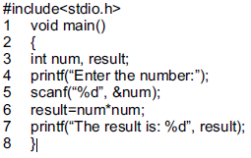

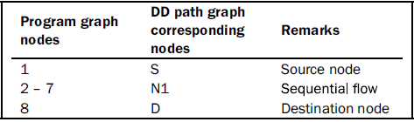

DD Path Graphs
The Decision to Decision (DD) path graph is an extension of a program graph.
There may be many nodes in a program graph which are in a sequence.
In DD path graph, such nodes which are in a sequence are combined into a block and are represented by a single node.

Slide 12
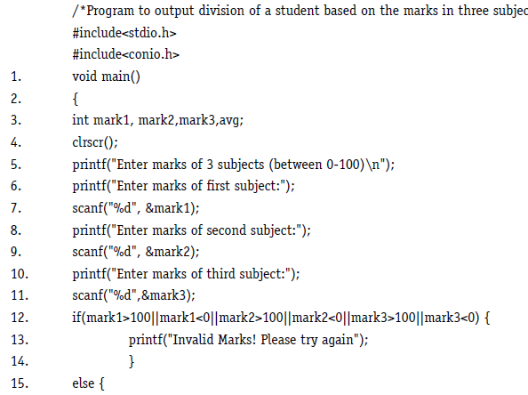
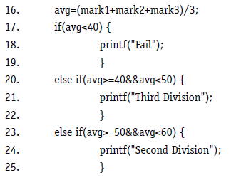
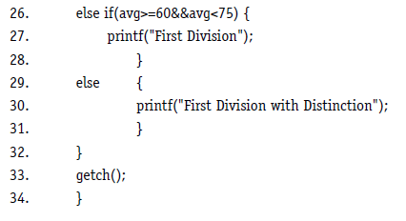
Example 1. Consider the program for the determination of division of a student. Its input is a triple of positive integers (mark1, mark2, mark3) and values are from interval [0, 100]. The output may be one of the following words: [First division with distinction, First division, Second division, Third division, Fail, Invalid marks]. Draw the program graph and the DD path graph.

Slide 13
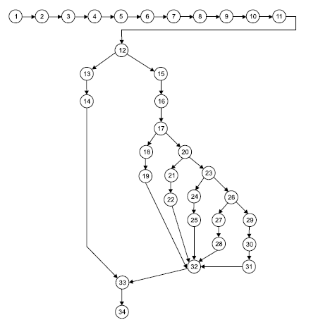
Program graph: Source code of determination of division of a student problem

Slide 14
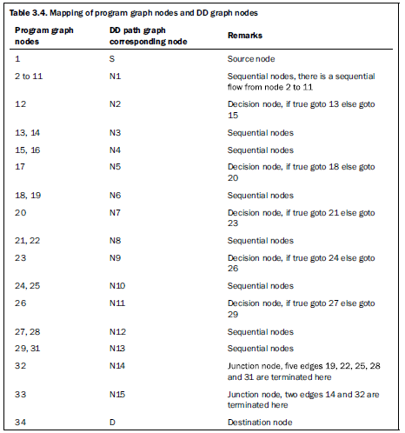
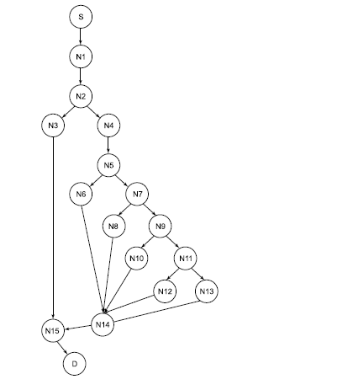
DD path graph of program to find division of a student

Slide 15
Example 2 : Consider the problem for determination of division of a student with the DD path graph given in Figure 3.17. Find cyclomatic complexity and also find independent paths.
Number of edges (e) = 21
Number of nodes (n) = 17
(i) V(G) = e – n + 2P = 21 – 17 + 2 = 6
(ii) V(G) = + 1 = 5 + 1 = 6
(iii) V(G) = Number of regions = 6
The independent paths are:
(i) S, N1, N2, N3, N15, D
(ii) S, N1, N2, N4, N5, N6, N14, N15, D
(iii) S, N1, N2, N4, N5, N7, N8, N14, N15, D
(iv) S, N1, N2, N4, N5, N7, N9, N10, N14, N15, D
(v) S, N1, N2, N4, N5, N7, N9, N11, N12, N14, N15, D
(vi) S, N1, N2, N4, N5, N7, N9, N11, N13, N14, N15, D

Slide 16
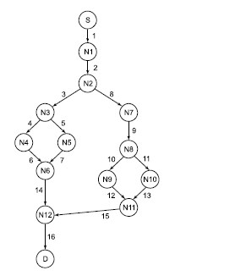
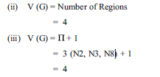
Example 3. Consider the following DD path graph (as given in Figure) and calculate the cyclomatic complexity. Also find independent paths
(i) V(G) = e – n + 2P
= 16 – 14 + 2
= 4
There are 4 independent paths as given below:
(i) S, N1, N2, N3, N4, N6, N12, D
(ii) S, N1, N2, N3, N5, N6, N12, D
(iii) S, N1, N2, N7, N8, N9, N11, N12, D
(iv) S, N1, N2, N8, N10, N11, N12, D

Slide 17
Example Consider the program for the determination of division of a student. Its input is a triple of positive integers (mark1, mark2, mark3) and values are from interval [0, 100]. The output may be one of the following words: [First division with distinction, First division, Second division, Third division, Fail, Invalid marks]. Draw the program graph and the DD path graph.

Slide 18
Control Flow Testing
Control flow testing is a software testing technique that helps ensure that the different paths a program can take are tested. It is a white-box testing technique.
The aim of this technique is to determine the execution order of statements or instructions of the program through a control structure.
The control structure of a program is used to develop a test case for the program.
In this technique, a particular part of a large program is selected by the tester to set the testing path. It is mostly used in unit testing.
Test cases represented by the control graph of the program.
Control Flow Graph is formed from the node, edge, decision node, junction node to specify all possible execution path.

Slide 19
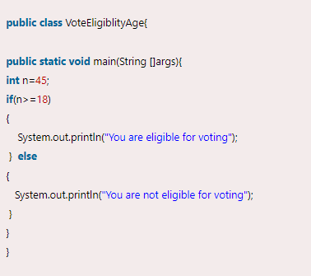
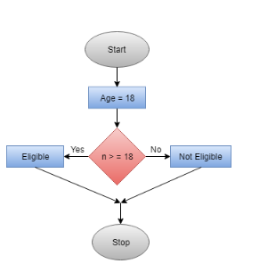
Control Flow Testing
In the control flow graph, start, age, eligible, not eligible and stop are the nodes, n>=18 is a decision node to decide which part (if or else) will execute as per the given value. Connectivity of the eligible node and not eligible node is there on the stop node.

Slide 20
Data Flow Testing:
Data flow testing is used to analyze the flow of data in the program. It is the process of collecting information about how the variables flow the data in the program. It tries to obtain particular information of each particular point in the process.
Data flow testing is a group of testing strategies to examine the control flow of programs in order to explore the sequence of variables according to the sequence of events.
It mainly focuses on the points at which values assigned to the variables and the point at which these values are used by concentrating on both points, data flow can be tested.
Data flow testing uses the control flow graph to detect illogical things that can interrupt the flow of data. Anomalies in the flow of data are detected at the time of associations between values and variables due to:
If the variables are used without initialization.
If the initialized variables are not used at least once.

Slide 21
Data Flow Testing: Consider the following program.
1. # include < stdio.h>
2. void main ()
3. {
4. int a, b, c;
5. a = b + c;
6. printf (“%d”, a);
7. }
Data flow testing focuses on variable definition and variable usage. In line number 5 of the above program, variable ‘a’ is defined and variables ‘b’ and ‘c’ are used. The variables are defined and used (referenced) throughout the program. Hence, this technique concentrates on how a variable is defined and used at different places of the program.
It is based on variables, their usage and their definition(s) (assignment) in the program.
The main points of concern are:
(i) Statements where variables receive values (definition).
(ii) Statements where these values are used (referenced).

Slide 22
1. Define/Reference Anomalies
Some of the define / reference anomalies are given as:
(i) A variable is defined but never used / referenced.
(ii) A variable is used but never defined.
(iii) A variable is defined twice before it is used.
(iv) A variable is used before even first-definition.
We may define a variable, use a variable and redefine a variable. So, a variable must be first defined before any type of its usage.
Define / reference anomalies may be identified by static analysis of the program i.e. analyzing program without executing it. This technique uses the program graphs to understand the ‘define / use’ conditions of all variables.

Slide 23
1. Definitions
Defining node: A program is first converted into a program graph. As we all know, every statement of a program is replaced by a node and flow of control by an edge to prepare a program graph. A node of a program graph is a defining node for a variable v, if and only if, the value of the variable is defined in the statement corresponding to that node. It is represented as DEF (v,n) where v is the variable and n is the node corresponding to the statement in which is defined.
Usage node: A node of a program graph is a usage node for a variable v , if and only if, the value of the variable v is used in the statement corresponding to that node. It is represented as USE (v, n), where ‘v’ is the variable and ‘n’ in the node corresponding to the statement in which ‘v’ is used. A usage node USE (v, n) is a predicate use node (denoted as P-use), if and only if, the statement corresponding to node ‘n’ is a predicate statement otherwise USE (v , n) is a computation use node (denoted as C-use).

Slide 24
1. Definitions
Definition use Path: A definition use path (denoted as du-path) for a variable ‘ v’ is a path between two nodes ‘m’ and ‘n’ where ‘m’ is the initial node in the path but the defining node for variable ‘ v’ (denoted as DEF ( v, m)) and ‘n’ is the final node in the path but usage node for variable ‘v ’ (denoted as USE ( v, n)).
Definition clear path : A definition clear path (denoted as dc-path) for a variable ‘v’ is a definition use path with initial and final nodes DEF (v, m) and USE (v , n) such that no other node in the path is a defining node of variable ‘v’.
The du-paths and dc-paths describe the flow of data across program statements from statements where values are defined to statements where the values are used. A du-path for a variable ‘v ’ may have many redefinitions of variable ‘v’ between initial node (DEF (v , m)) and final node (USE (v , n)). A dc-path for a variable ‘v ’ will not have any definition of variable ‘v’ between initial node (DEF (v , m)) and final node (USE (v, n)). The du-paths that are not definition clear paths are potential troublesome paths. They should be identified and tested on topmost priority.

Slide 25

Identification of du and dc Paths
The various steps for the identification of du and dc paths are given as:
(i) Draw the program graph of the program.
(ii) Find all variables of the program and prepare a table for define / use status of all variables using the following format:
(iii) Generate all du-paths from define/use variable table of step (iii) using the following
format:
(iv)Identify those du-paths which are not dc-paths.

Slide 26
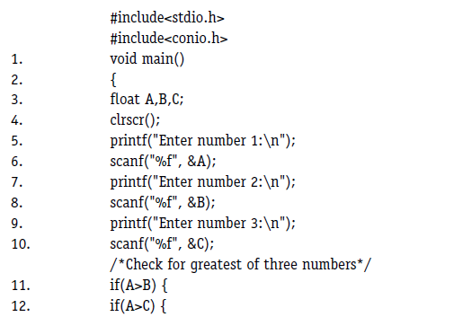
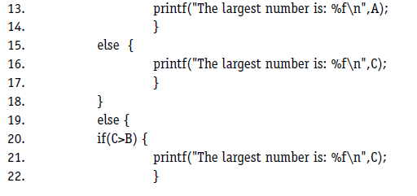
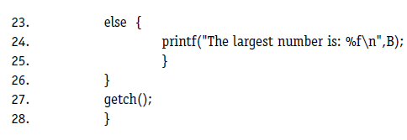
Consider the program given in Figure to find the largest number amongst three numbers. Its program graph is given in Figure There are three variables in the program namely A, B and C. Define /use nodes for all these variables are given below:

Slide 27
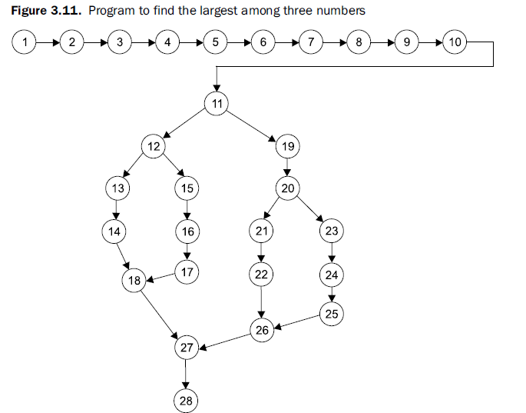

Slide 28
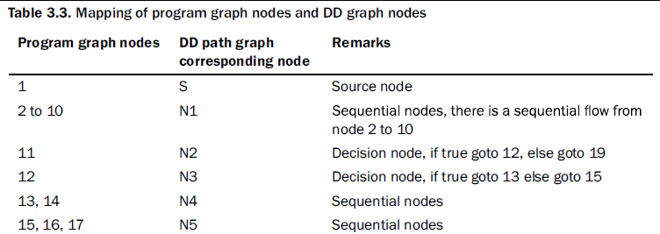
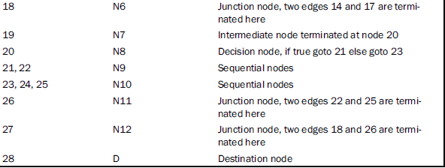

Slide 29
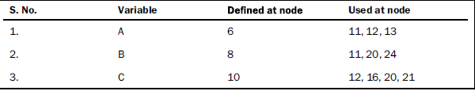
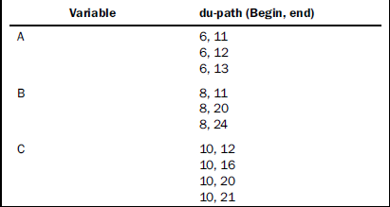
There are three variables in the program namely A, B and C. Define /use nodes for all these variables are given below:
The du-paths with beginning node and end node are given as:

Slide 30
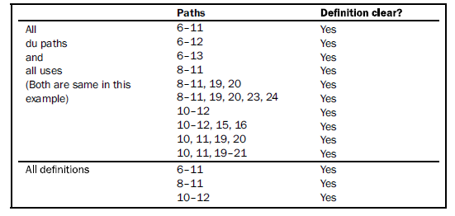
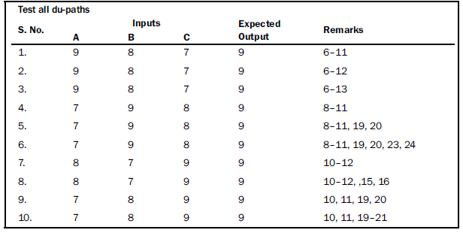
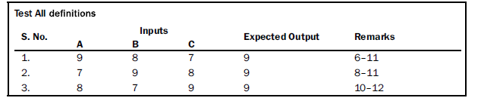
The first strategy (best) is to test all du-paths, the second is to test all uses and the third is to test all definitions. The du-paths as per these three strategies are given as:

Slide 31
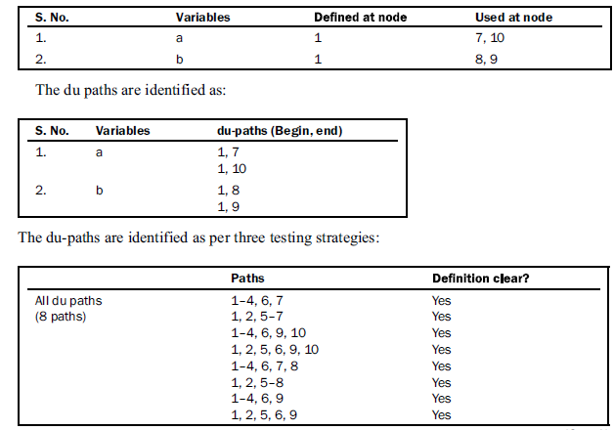
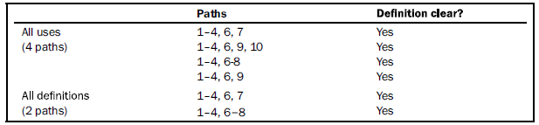

Slide 32
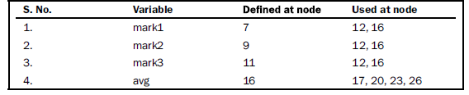
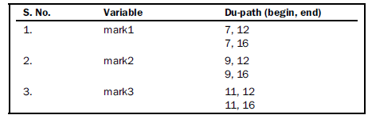
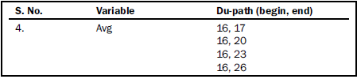
Example 4.4: Consider the program for the determination of the division problem. Its input is a triple of positive integers (mark1, mark2, mark3) and values for each of these may be from interval [0, 100]. The program is given in Figure 3.15. The output may have one of the options given below: (i) Fail (ii) Third division (iii) Second division (iv) First division (v) First division with distinction (vi) Invalid marks Find all du-paths and identify those du-paths that are definition clear. Also find all du-paths, all-uses and all-definitions and generate test cases for these paths.
(i) The program graph is given in Figure 3.16. The variables used in the program are mark1, mark2, mark3, avg. (ii) The define/ use nodes for all variables are given below:
(iii) The du-paths with beginning and ending nodes are given as:

Slide 33
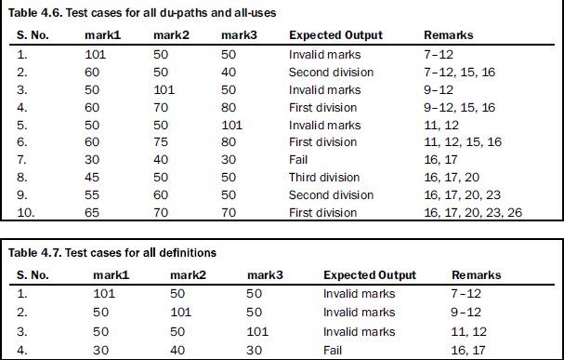
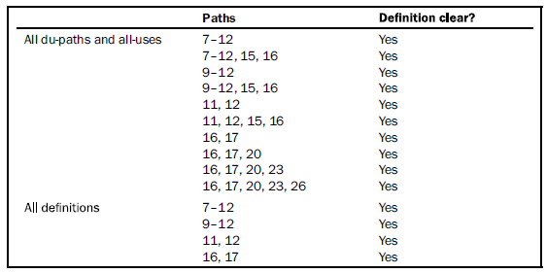
All du-paths, all-uses and all-definitions are given below:

Slide 34
Code Coverage:
Code coverage is a measure which describes the degree of which the source code of the program has been tested.
It also creates some test cases to increase coverage and determining a quantitative measure of code coverage.
Code coverage system gathers information about the running program.
It also combines that with source code information to generate a report about the test suite’s code coverage.
Here, are some prime reasons for using code coverage:
It helps you to measure the efficiency of test implementation
It offers a quantitative measurement.
It defines the degree to which the source code has been tested.

Slide 35

Statement Coverage:
Statement Coverage is a white box testing technique in which all the executable statements in the source code are executed at least once.
The main purpose of Statement Coverage is to cover all the possible paths, lines and statements in source code.
It is used for calculation of the number of statements in source code which have been executed.

Slide 36
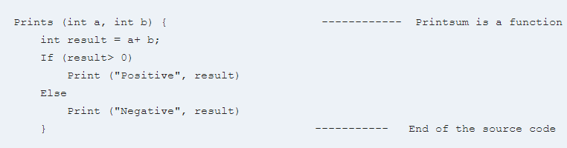
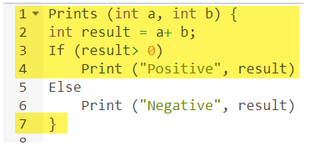
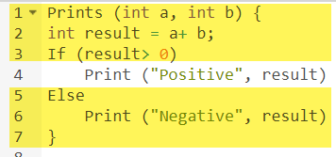
Statement Coverage : Example
Scenario 1: if A=3,B=9
Scenario 1: if A=-3,B=-9

Slide 37
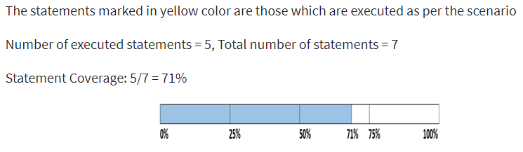
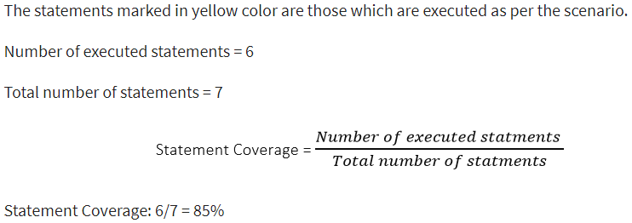
Statement Coverage : Example
Scenario 1: if A=3,B=9
Scenario 2: if A=-3,B=-9

Slide 38

Decision Coverage
The goal of decision coverage testing is to cover and validate all the accessible source code by checking and ensuring that each branch of every possible decision point is executed at least once.
Whenever there is a possibility of two or more outcomes from the statements like do while statement, if statement and case statement (Control flow statements), it is considered as decision point because there are two outcomes either true or false.
Decision coverage covers all possible outcomes of each and every Boolean condition of the code by using control flow graph or chart.

Slide 39
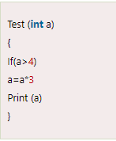
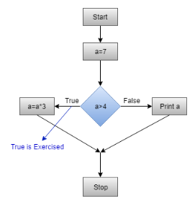
Decision Coverage: Example of decision coverage Consider the following code.
Scenario 1: Value of a is 7 (a=7)
Test (int a=7)
{ if (a>4)
a=a*3
print (a)
}
Decision Coverage = ½*100 (Only "True" is exercised)
=100/2 = 50 , Decision Coverage is 50%

Slide 40
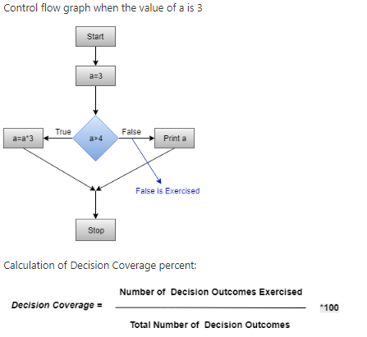
Decision Coverage: Example of decision coverage Consider the following code-
Scenario 2:Value of a is 3 (a=3)
Test (int a=3)
{ if (a>4)
a=a*3
print (a)
}
DC= ½*100 (Only "False" is exercised) =100/2 = 50 Decision Coverage = 50%

Slide 41

Branch Coverage:
Branch coverage technique is used to cover all branches of the control flow graph.
It covers all the possible outcomes (true and false) of each condition of decision point at least once.
Branch coverage technique is a white-box testing technique that ensures that every branch of each decision point must be executed.
However, branch coverage technique and decision coverage technique are very similar, but there is a key difference between the two. Decision coverage technique covers all branches of each decision point whereas branch testing covers all branches of every decision point of the code.
The formula to calculate Branch Coverage:

Slide 42
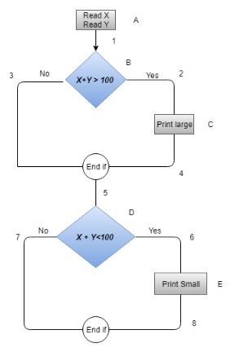
Branch Coverage : Example of Branch Coverage
`1.Read X
2.Read Y
3.IF X+Y > 100 THEN
4.Print "Large"
5.ENDIF
6.If X + Y<100 THEN
7.Print "Small"
8.ENDIF
In the above diagram, control flow graph of code is depicted. In the first case traversing through "Yes "decision, the path is A1-B2-C4-D6-E8, and the number of covered edges is 1, 2, 4, 5, 6 and 8 but edges 3 and 7 are not covered in this path. To cover these edges, we have to traverse through "No" decision. In the case of "No" decision the path is A1-B3-5-D7, and the number of covered edges is 3 and 7. So by traveling through these two paths, all branches have covered.

Slide 43
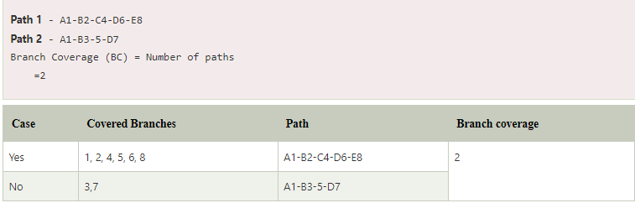
Branch Coverage:

Slide 44
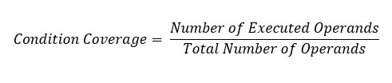
Condition Coverage:
Condition Coverage or expression coverage is a testing method used to test and evaluate the variables or sub-expressions in the conditional statement.
The goal of condition coverage is to check individual outcomes for each logical condition. Condition coverage offers better sensitivity to the control flow than decision coverage. In this coverage, expressions with logical operands are only considered.
For example, if an expression has Boolean operations like AND, OR, XOR, which indicates total possibilities.
Condition coverage does not give a guarantee about full decision coverage.
The formula to calculate Condition Coverage:

Slide 45

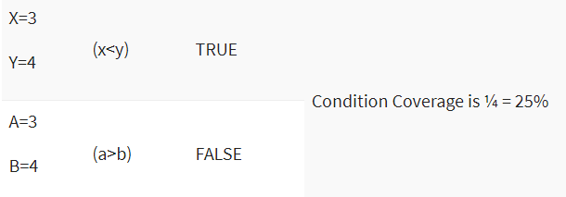
Example:
For the above expression, we have 4 possible combinations
TT
FF
TF
FT

Slide 46
Pre-condition and post-condition:
A precondition is a condition that must be true before a method runs for it to work. The operation is not guaranteed to perform as it should unless the precondition has been met
A postcondition is a condition that can be guaranteed after a method is finished. If the operation is correct and the precondition(s) met, then the postcondition is guaranteed to be true.
Real world examples
Eating a pizza — precondition: there is a pizza; postcondition: there is no pizza
Withdrawing money from a debit account in ATM — preconditions: the sum being withdrawn should be smaller than or equal to the sum remaining on the account and smaller than the sum remaining in the ATM;
postconditions: the reminders of money in both ATM and on the account should equal their original values minus the sum being withdrawn.

Slide 47
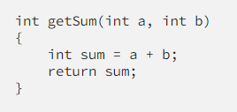
Pre-condition and Post-condition: Example
Let’s imagine that we have a function that computes the square root of a number. So the preconditions here are the argument to the square root function must be non-negative and greater than or equal to zero. The postcondition is the square of the computed result must equal the argument. We could express it this way:
def square_root(x):
assert x >= 0 // _preconditions_
THE COMPUTATION ITSELF... RETURNS A VALUE NAMED Y
assert y*y == x // _postcondition_
return y

Slide 48
Check Pointing:
Testing in checkpoints helps ensure that the software is functioning correctly and meeting the desired requirements at each stage of development.
It involves executing various tests, such as unit testing, integration testing, and system testing, to identify and address any issues or bugs before progressing to the next checkpoint.
By conducting testing in checkpoints, developers can catch and resolve issues early on, preventing them from escalating into larger problems later in the development cycle.
It allows for iterative improvements and provides feedback on the software's stability, functionality, and performance at different stages of development.

Slide 49
Check Pointing: Different types of check points
Milestone Checkpoints: These checkpoints are typically based on project milestones or key deliverables. They mark significant progress points in the development process, such as the completion of a major feature, module, or phase.
Feature Checkpoints: These checkpoints focus on specific features or functionalities within the software. They ensure that each feature is developed, tested, and integrated properly before moving on to the next checkpoint.
Integration Checkpoints: Integration checkpoints verify the successful integration of different components or modules of the software. They ensure that the individual parts of the system work together as intended and are properly integrated into a cohesive whole.
Regression Checkpoints: Regression checkpoints involve running tests to check for any unintended side effects or regression issues introduced by recent changes or updates. They ensure that the software continues to function correctly after modifications and updates have been made.
User Acceptance Checkpoints: User acceptance checkpoints involve testing the software from the end-user's perspective. It allows users or stakeholders to evaluate the software against their requirements and provide feedback before finalizing the development.
Performance Checkpoints: Performance checkpoints focus on evaluating the performance and efficiency of the software. This may involve stress testing, load testing, or performance profiling to ensure the software can handle expected workloads and meet performance expectations.

Slide 50
Test Schedule and Its Sample Template
A test schedule includes the testing steps or tasks, the target start and end dates, and responsibilities.
It should also describe how the test will be reviewed, tracked, and approved.

Slide 51
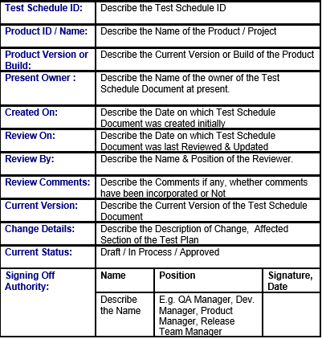
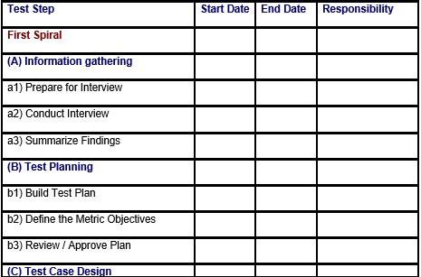
Test Schedule and Its Sample Template

Slide 52
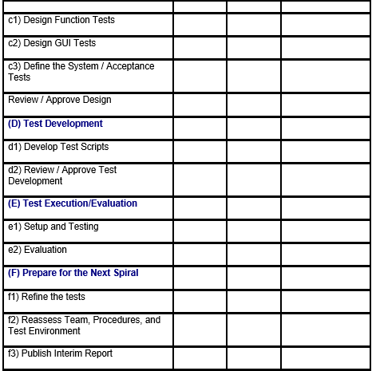
Test Schedule and Its Sample Template

Slide 53
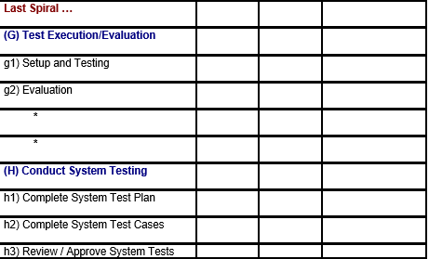
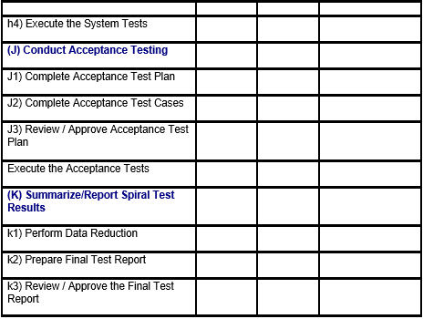
Test Schedule and Its Sample Template

Slide 54
Test Data Selection
In software testing, test data refers to the input values, conditions, and scenarios useful for validating and verifying the functionality, performance, and behavior of the software.
It is crucial because it helps assess the software’s performance under various circumstances and ensures that the product meets the specified requirements and functions.
Why is Test Data Important?
The importance of test data within the context of software testing is crucial. It serves as a fundamental component, facilitating defect identification, performance assessment, and assurance of software reliability.
A well-defined, comprehensive set of test data in software testing kickstarts the first step toward testing the software against real-world conditions.
Many systems run without errors when there is no external load on them, but only a few can continue when users start actively navigating them. Test data makes sure that your software runs as perfectly for the customers as you want it to.

